Slide 1
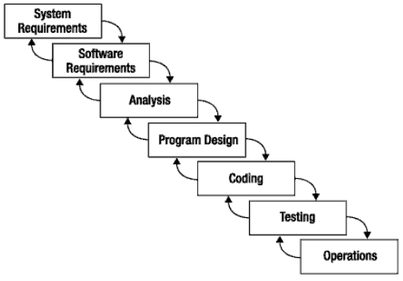
What is Scrum?
Scrum:
  Is an agile, lightweight process
  Can manage and control software and product development
  Uses iterative, incremental practices
  Has a simple implementation
  Increases productivity
  Reduces time to benefits
  Embraces adaptive, empirical systems development
  Is not restricted to software development projects
  Embraces the opposite of the waterfall approach…
It’s about common sense

Slide 2
Scrum at a Glance
24 hours
Daily Scrum
Meeting
Backlog tasks
expanded
by team
30 days
Sprint Backlog
Potentially Shippable
Product Increment
Product Backlog
As prioritized by Product Owner
Source: Adapted from Agile Software Development with Scrum by Ken Schwaber and Mike Beedle.

Slide 3



Sequential vs. Overlap
Requirements
Design
Code
Test
Rather than doing all of one thing at a time...
...Scrum teams do a little of everything all the time

Slide 4
Scrum Framework
Roles
Product owner
Scrum Master
Team
Ceremonies
Sprint planning
Sprint review
Sprint retrospective
Daily scrum meeting
Artifacts
Product backlog
Sprint backlog
Burndown charts

Slide 5







Scrum Roles
  Product Owner
    Possibly a Product Manager or Project Sponsor
    Decides features, release date, prioritization, $$$
  Scrum Master
    Typically a Project Manager or Team Leader
    Responsible for enacting Scrum values and practices
  Project Team
    5-10 members; Teams are self-organizing
    Cross-functional: QA, Programmers, UI Designers, etc.
    Membership should change only between sprints

Slide 6


Sprint Planning Mtg.
Team capacity
Sprint planning meeting
Sprint prioritization
Sprint
goal
Product backlog
Analyze/evaluate product backlog
Select sprint goal
Business conditions
Sprint planning
Decide how to achieve sprint goal (design)
Create sprint backlog (tasks) from product backlog items (user stories / features)
Estimate sprint backlog in hours
Current product
Sprint
backlog
Technology

Slide 7
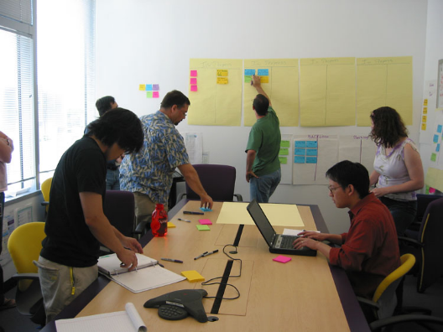
Daily Scrum Meeting
Parameters
  Daily, ~15 minutes, Stand-up
  Anyone late pays a $1 fee
Not for problem solving
  Whole world is invited
  Only team members, Scrum Master, product owner, can talk
  Helps avoid other unnecessary meetings
Three questions answered by each team member:
  What did you do yesterday?
  What will you do today?
  What obstacles are in your way?

Slide 8
Scrum's Artifacts
Scrum has remarkably few artifacts
  Product Backlog
  Sprint Backlog
  Burndown Charts
  A sprint backlog is the set of items that a cross-functional product team selects from its product backlog to work on during the upcoming sprint. Typically the team will agree on these items during its sprint planning session. In fact, the sprint backlog represents the primary output of sprint planning.
Can be managed using just an Excel spreadsheet
  More advanced / complicated tools exist:
    Expensive
    Web-based – no good for Scrum Master/project manager who travels
    Still under development

Slide 9

Product Backlog
The requirements
A list of all desired work on project
Ideally expressed as a list of user stories along with "story points", such that each item has value to users or customers of the product
Prioritized by the product owner
Reprioritized at start of each sprint
This is the
product backlog

Slide 10
User Stories
Instead of Use Cases, Agile project owners do "user stories"
  Who (user role) – Is this a customer, employee, admin, etc.?
  What (goal) – What functionality must be achieved/developed?
  Why (reason) – Why does user want to accomplish this goal?
As a [user role], I want to [goal], so I can [reason].
Example:
  "As a user, I want to log in, so I can access subscriber content."
story points: A story point is a number that tells the team about the difficulty level of the story.
Rating of effort needed to implement this story
  common scales: 1-10, shirt sizes (XS, S, M, L, XL), etc.

Slide 11
Sample Product Backlog
Backlog item | Estimate
Allow a guest to make a reservation | 3 (story points)
As a guest, I want to cancel a reservation. | 5
As a guest, I want to change the dates of a reservation. | 3
As a hotel employee, I can run RevPAR reports (revenue-per-available-room) | 8
Improve exception handling | 8
... | 30
... | 50

Slide 12
Sprint Backlog
Individuals sign up for work of their own choosing
  Work is never assigned
Estimated work remaining is updated daily
Any team member can add, delete change sprint backlog
Work for the sprint emerges
If work is unclear, define a sprint backlog item with a larger amount of time and break it down later
Update work remaining as more becomes known

Slide 13
Sample Sprint backlog
Tasks
Mon
Tue
Wed
Thu
Fri
Code the user interface
8
4
8
Code the middle tier
16
12
10
4
Test the middle tier
8
16
16
11
8
Write online help
12
Write the Foo class
8
8
8
8
8
Add error logging
8
4

Slide 14
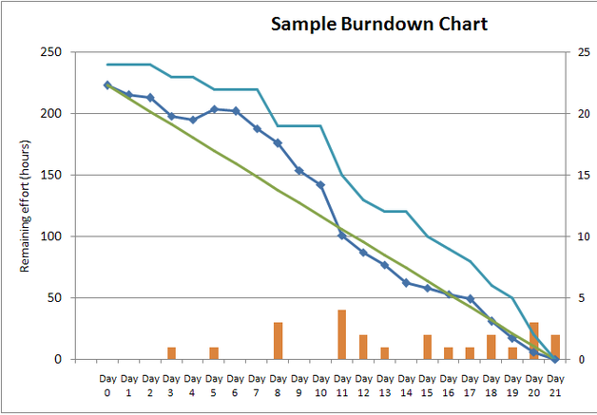
Sprint Burndown Chart
A display of what work has been completed
and what is left to complete
  one for each developer or work item
  updated every day
  (make best guess about hours/points completed each day)
variation: Release burndown chart
  shows overall progress
  updated at end of each sprint

Slide 15
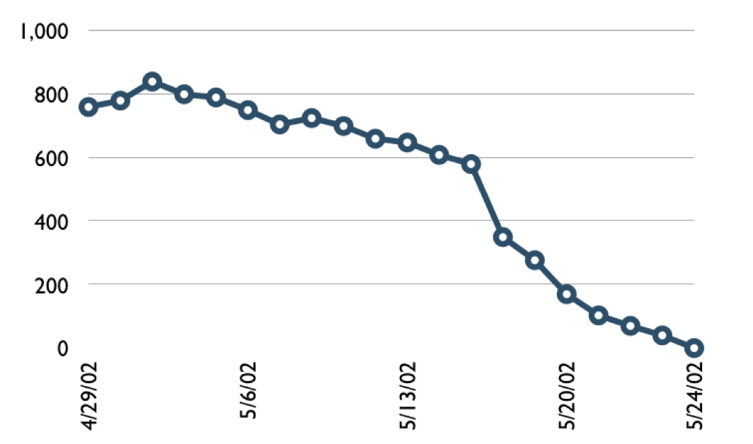

Sample Burndown Chart
Hours

Slide 16
Tasks
Mon
Tue
Wed
Thu
Fri
Code the user interface
8
4
8
Code the middle tier
16
12
10
7
Test the middle tier
8
16
16
11
8
Write online help
12
50
40
30
Hours
20
10
0
Mon
Tue
Wed
Thu
Fri

Slide 17
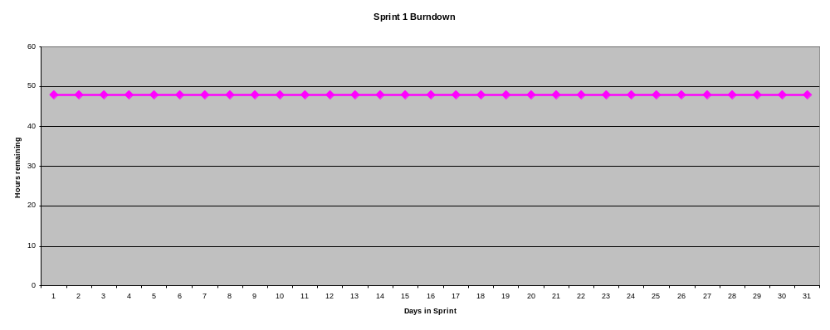
Burndown Example 1
No work being performed

Slide 18
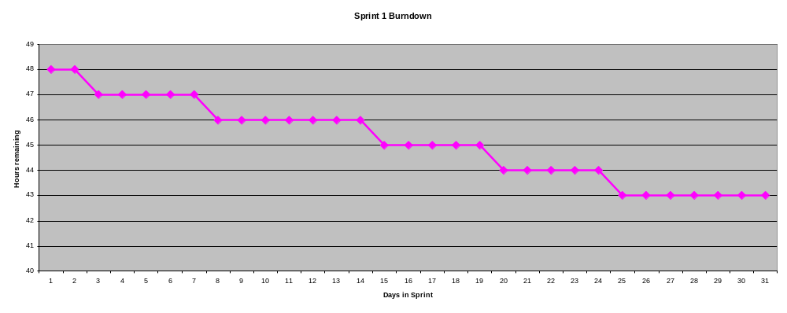
Burndown Example 2
Work being performed, but not fast enough

Slide 19
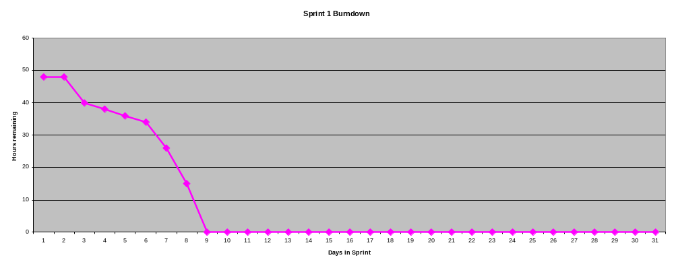
Burndown Example 3
Work being performed, but too fast!

Slide 20
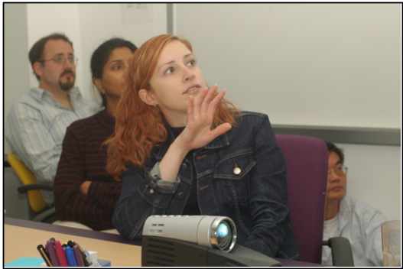
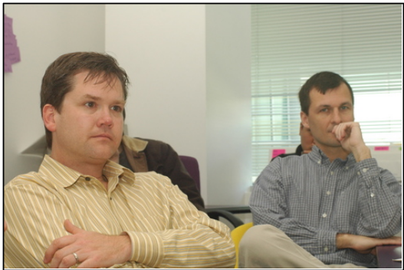
The Sprint Review
Team presents what it accomplished during the sprint
Typically takes the form of a demo of new features or underlying architecture
Informal
  2-hour prep time rule
  No slides
Whole team participates
Invite the world

Slide 21
Scalability
Typical individual team is 7 ± 2 people
  Scalability comes from teams of teams
Factors in scaling
  Type of application
  Team size
  Team dispersion
  Project duration
Scrum has been used on multiple 500+ person projects

Slide 22






Scaling: Scrum of Scrums

Slide 23
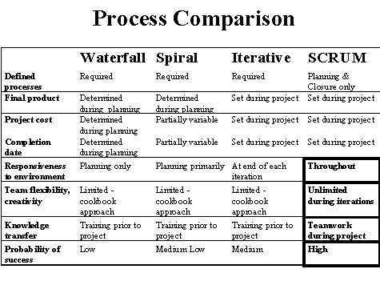
Scrum vs. Other Models

Slide 24

Credits, References
  Mike Cohn, Mountain Goat Software
  www.mountaingoatsoftware.com
  Scrum and The Enterprise by Ken Schwaber
  Succeeding with Agile by Mike Cohn
  Agile Software Development Ecosystems by Jim Highsmith
  Agile Software Development with Scrum by K. Schwaber and M. Beedle
  User Stories Applied for Agile Software Development by Mike Cohn
  www.agilescrum.com/
  www.objectmentor.com
  jeffsutherland.com/
  www.controlchaos.com/scrumwp.htm
  agilealliance.com/articles/articles/InventingScrum.pdf

